Slide 1




HOPE TO SKILL
Lecture 39
VectorDB
Chatbot
Artificial Intelligence Advance Course

Slide 2





AI INSTRUCTORS
Dr.Irfan Malik
Dr.Sheraz Naseer
Dr.Shazia Saqib
Ramsha Imran
M.Haris Tariq

Slide 3


Previous Lecture Topics
01
Splitters in LangChain
02
Types of splitters
03
Embedding

Slide 4
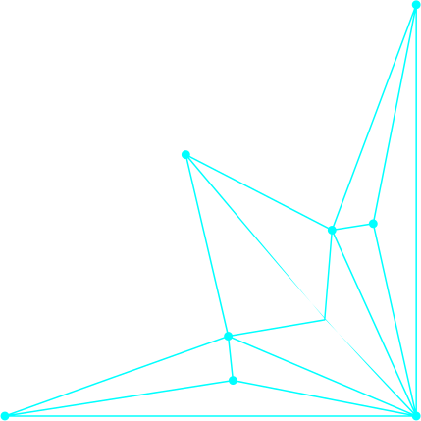

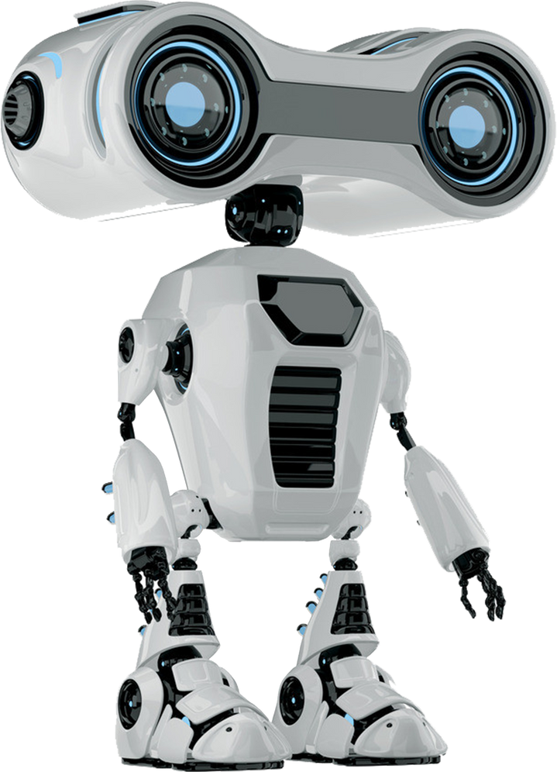
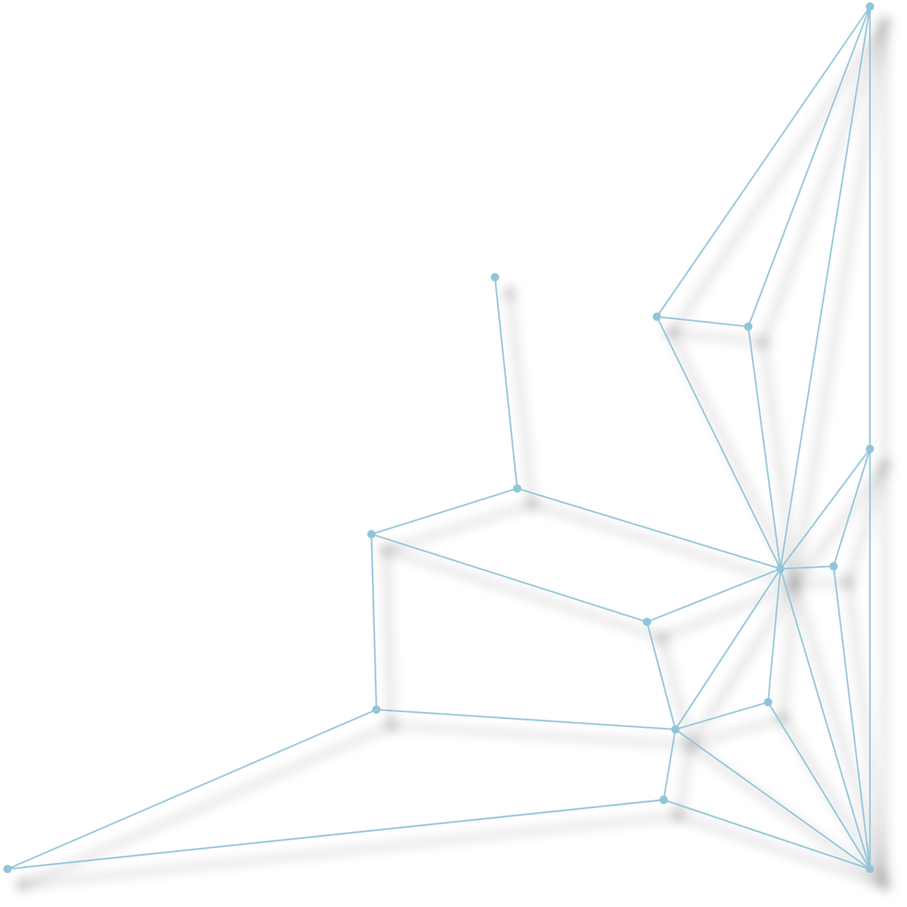
Outline
Introduction to Vector Stores
Local Storage Vs Cloud Storage

Slide 5


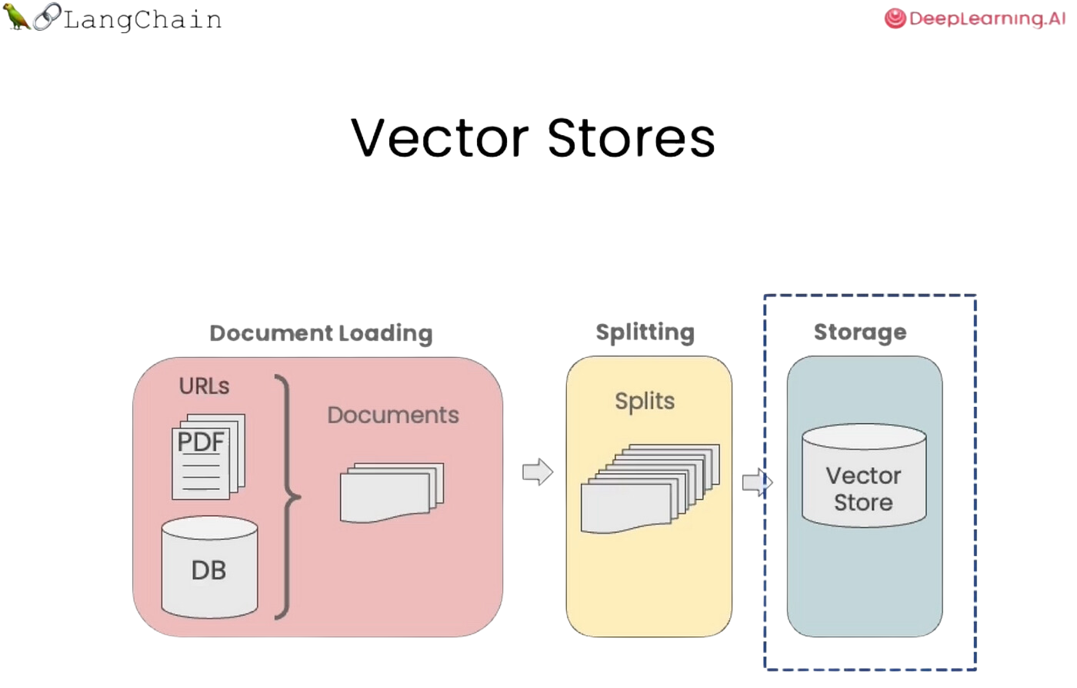
Introduction to Vector Stores
Definition: Vector stores are specialized databases optimized for storing and querying high-dimensional vector data.

Slide 6

Introduction to Vector Stores
Purpose: Used primarily in machine learning and data retrieval applications.
Key Features:
High-speed similarity search
Scalability Integration with ML pipelines

Slide 7
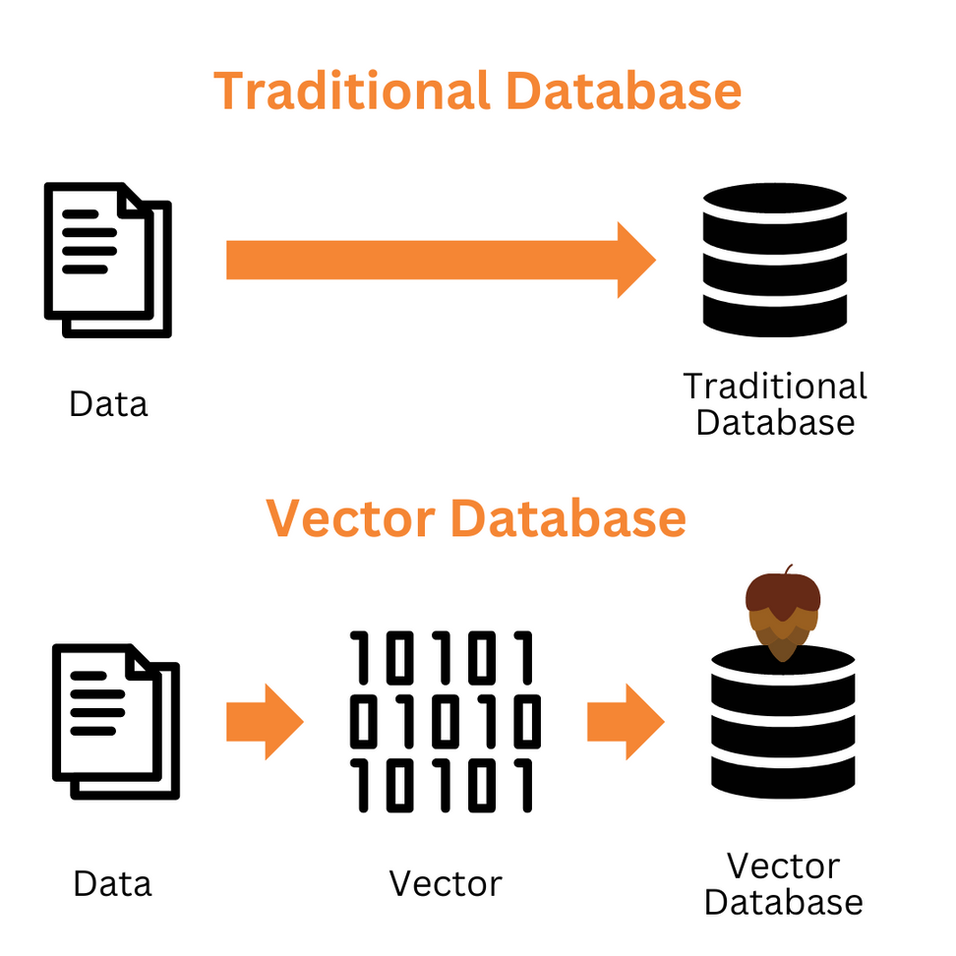

Slide 8
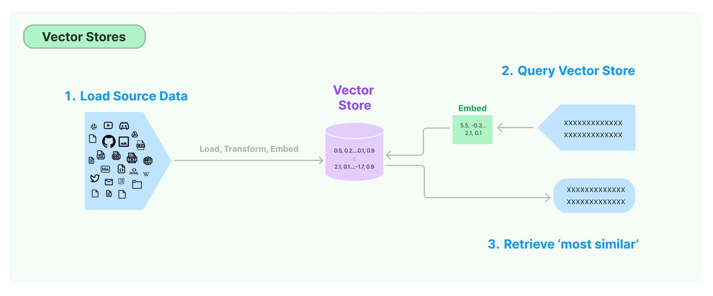
LangChain and Vector Stores
Integration: LangChain provides seamless
integration with vector stores, enabling you
to build powerful language applications.

Slide 9


LangChain and Vector Stores
Key benefits:
Fast
retrieval
Improved
semantic
understanding.
Efficient
data storage

Slide 10


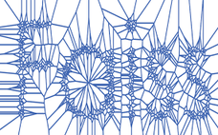
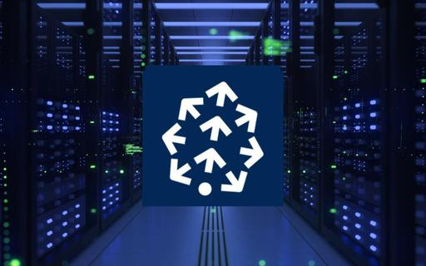


Vector Stores
Faiss
Pinecone
Chroma
Qdrant

Slide 11

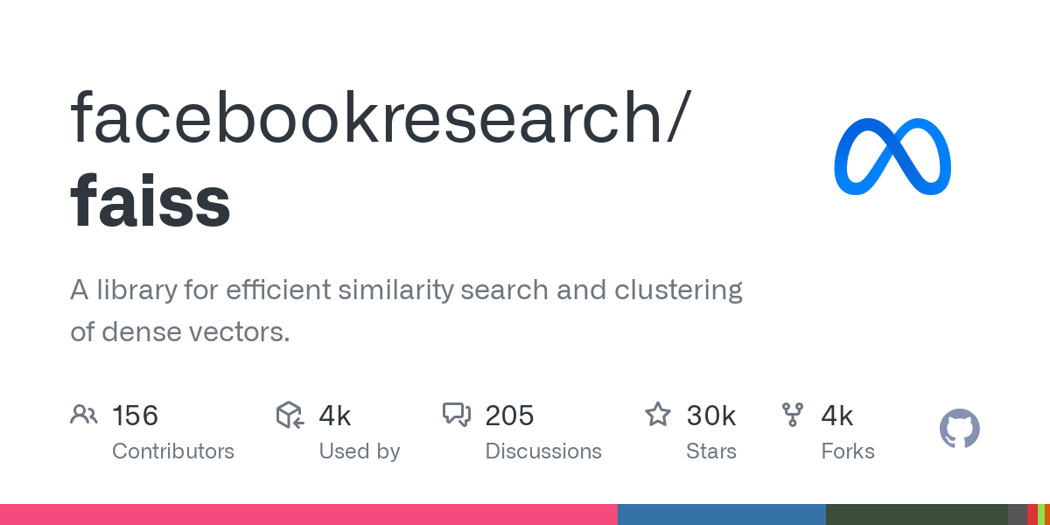
FAISS
FAISS is a library for efficient similarity search and clustering of dense vectors developed by Facebook AI.
It is optimized for fast nearest neighbor search in high-dimensional spaces.
It stores data locally

Slide 12
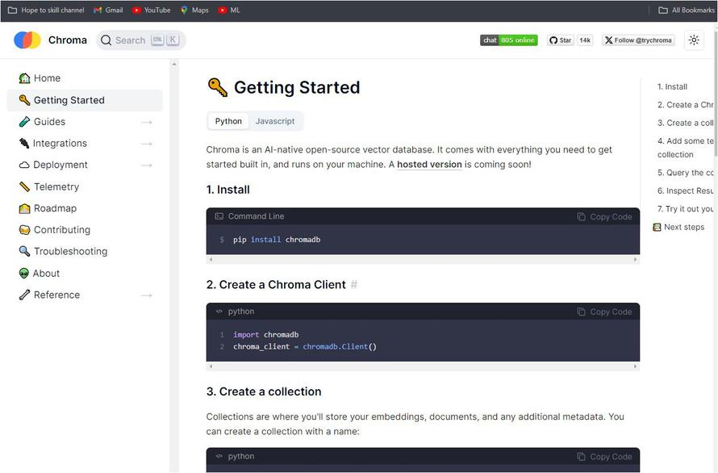
ChromaDB
ChromaDB is a powerful, open-source vector database specifically designed for LLM applications.
It can be used in Python or JavaScript with the chromadb library for local use, or connected to a remote server running Chroma.

Slide 13
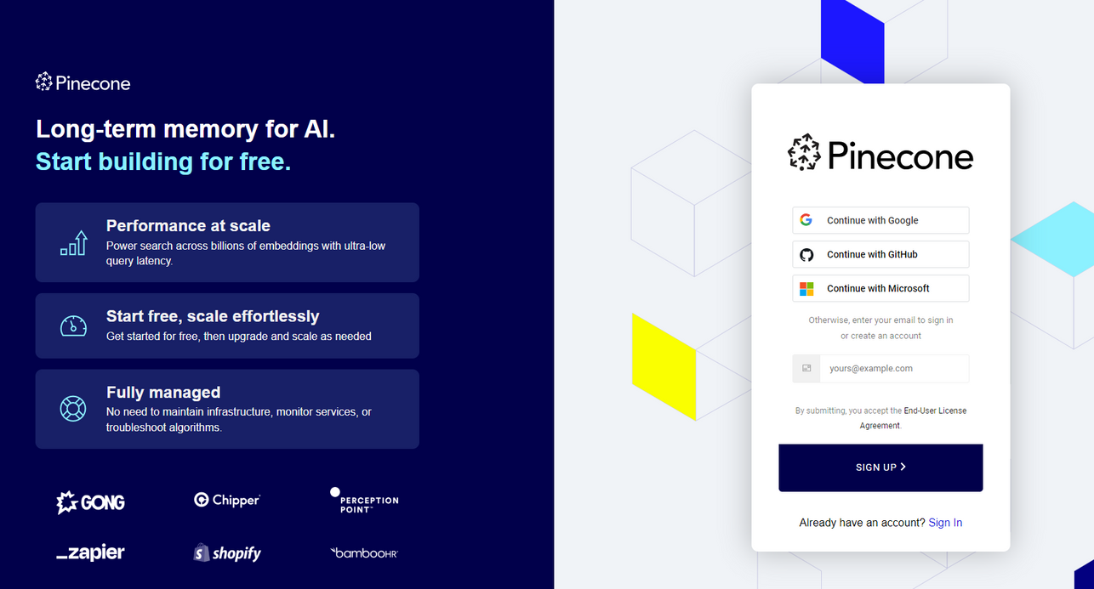
Pinecone
Introduction: Pinecone is a managed
vector database.

Slide 14
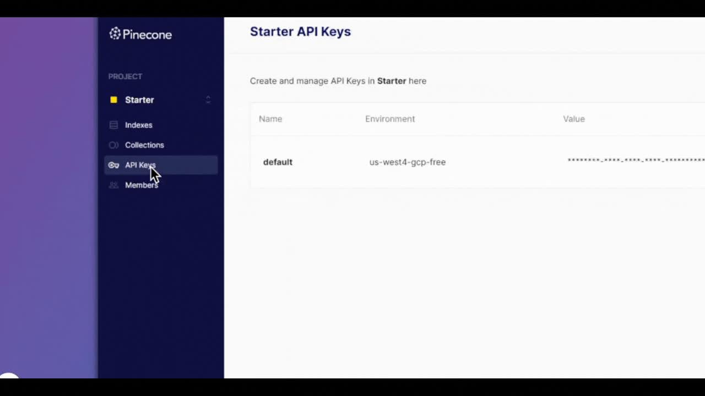
Pinecone
Key Features:
Real-time indexing Scalable
and distributed
Easy-to-use API Integrationwith
popular ML frameworks

Slide 15

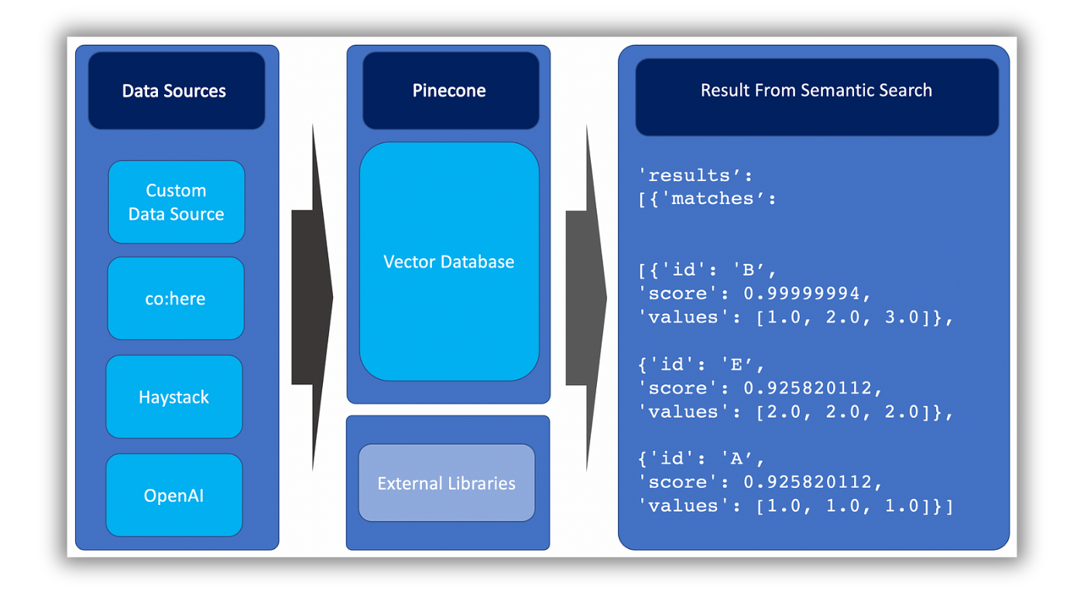

Pinecone
Use Cases:
Semantic search

Slide 16
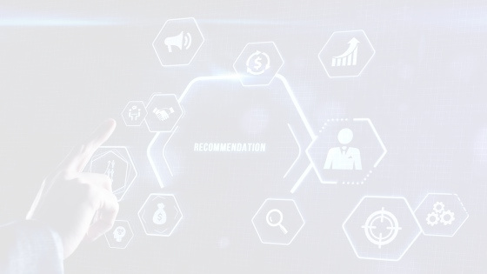
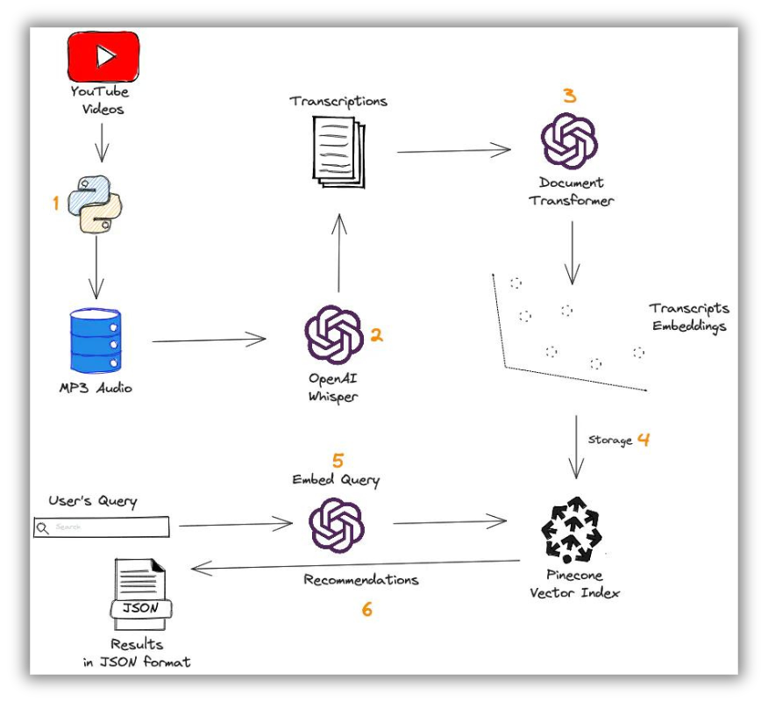
Pinecone
Use Cases:
Recommendation
systems

Slide 17
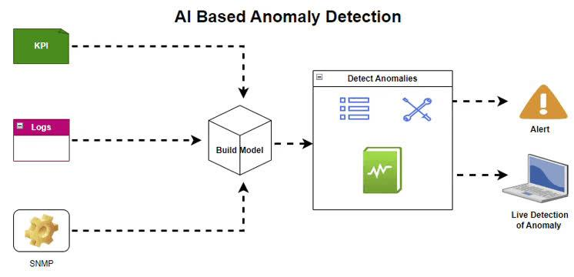
Pinecone
Use Cases:
Anomaly detection

Slide 18

Pinecone Architecture
Components:
Indexes
Namespace
Metadata support

Slide 19
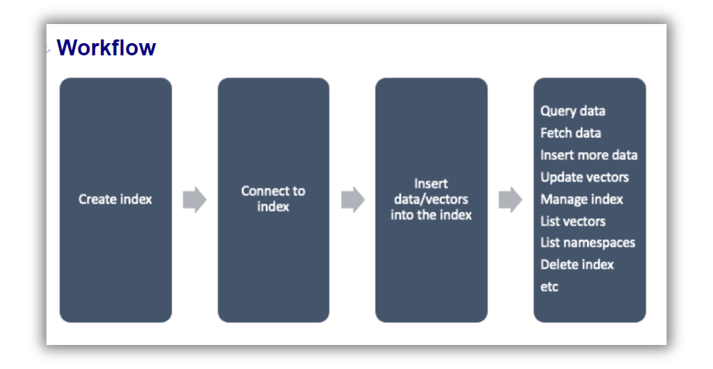
Workflow:
Data ingestion
Vector indexing
Query processing
Pinecone Architecture

Slide 20
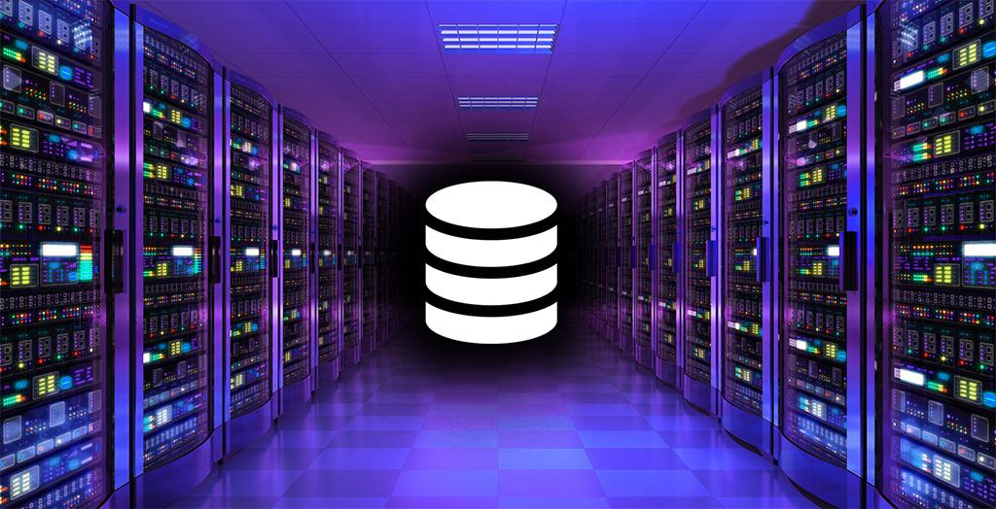
Pinecone Architecture
Advantages:
Fully managed service
Low-latency searches
High availability

Slide 21
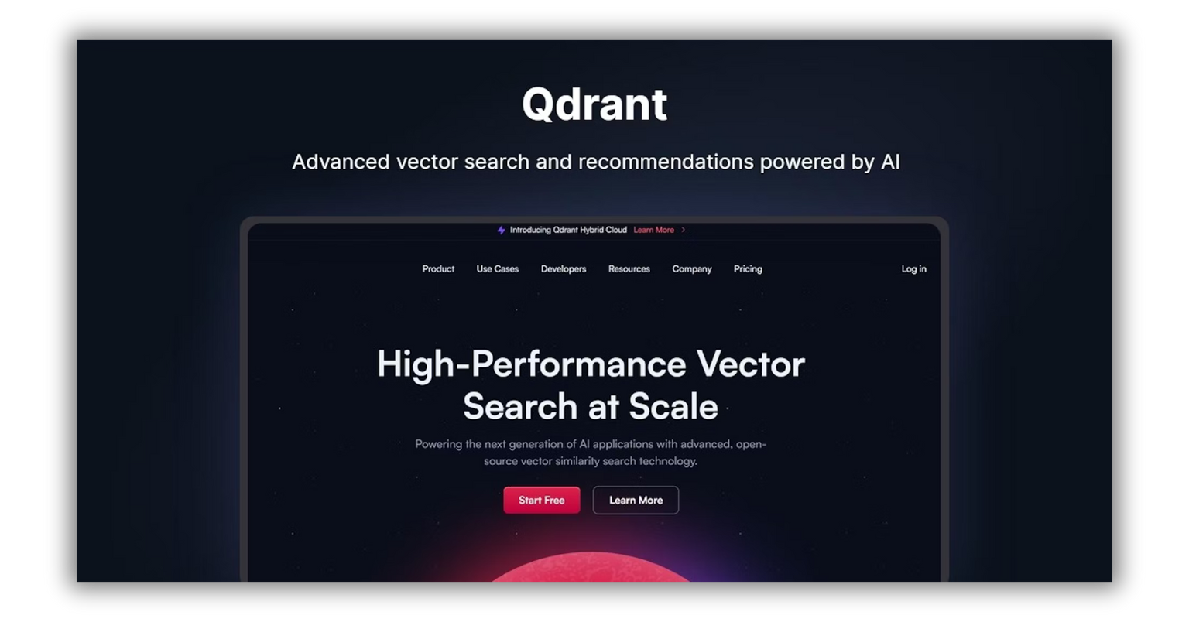
Qdrant Overview
Introduction: Qdrant is an open-source
vector database.

Slide 22

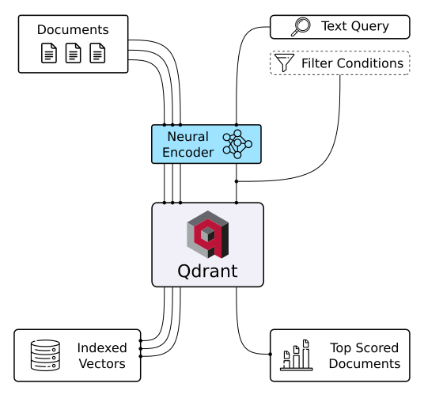
Qdrant Overview
Key Features:
Real-time vector search
Highly customizable
Integration with various data sources
Community support

Slide 23
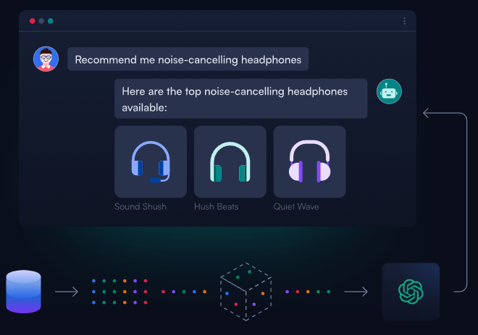
Qdrant Overview
Use Cases:
Vector search for NLP applications
Personalized recommendations
Image and video retrieval

Slide 24
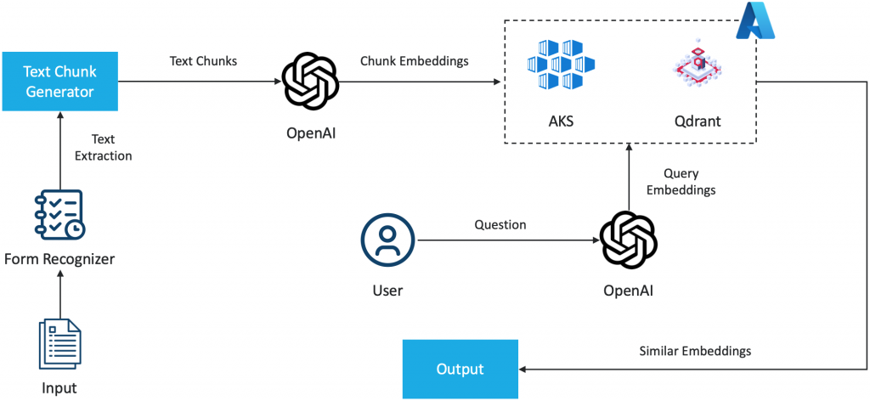
Qdrant Architecture
Workflow:
Data import
Vector creation
Search and retrieval

Slide 25
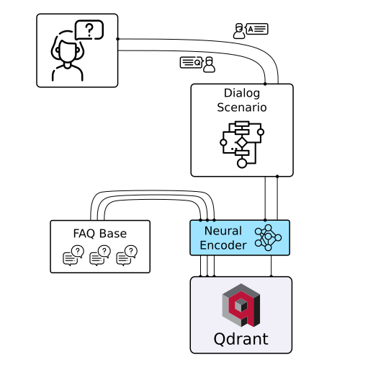
Qdrant Architecture
Advantages:
Open-source and flexible
Community-driven enhancements
Easy deployment

Slide 26


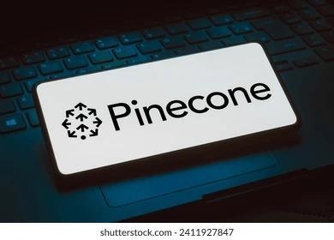

When to Use Qdrant and When to Use Pinecone
Choosing between Pinecone and Qdrant depends
on your specific needs, resources, and
project requirements.

Slide 27
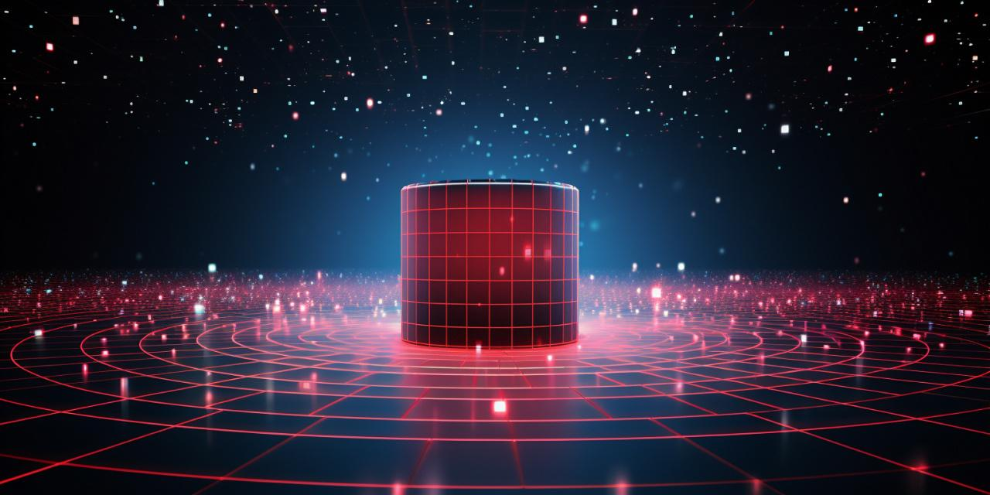
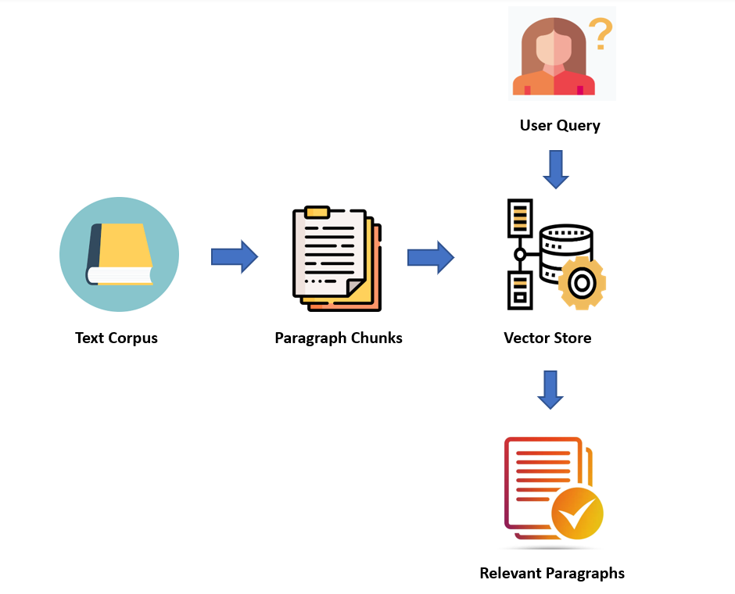
Querying from vector store
Once the documents embeddings are saved in vector store the user can query and retriever will retrieve the relevant chunks.

Slide 28

Tutorial

